Slide 1
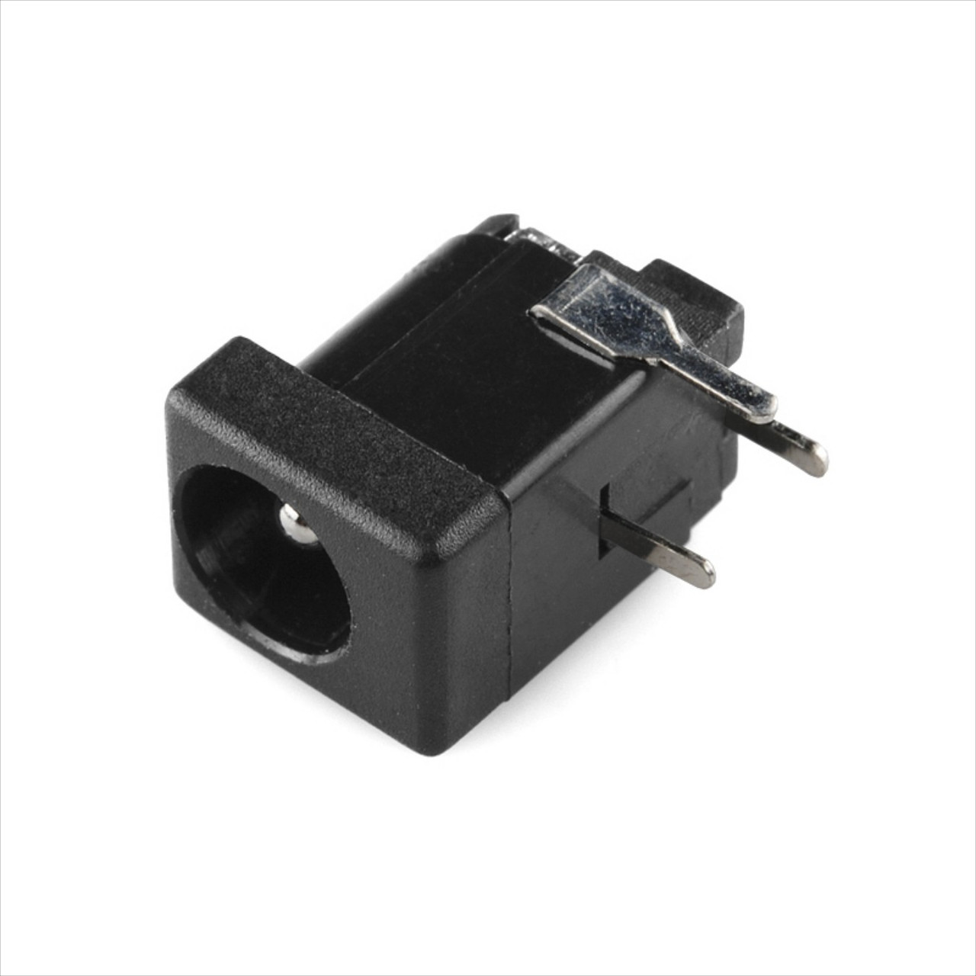
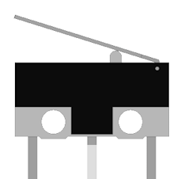
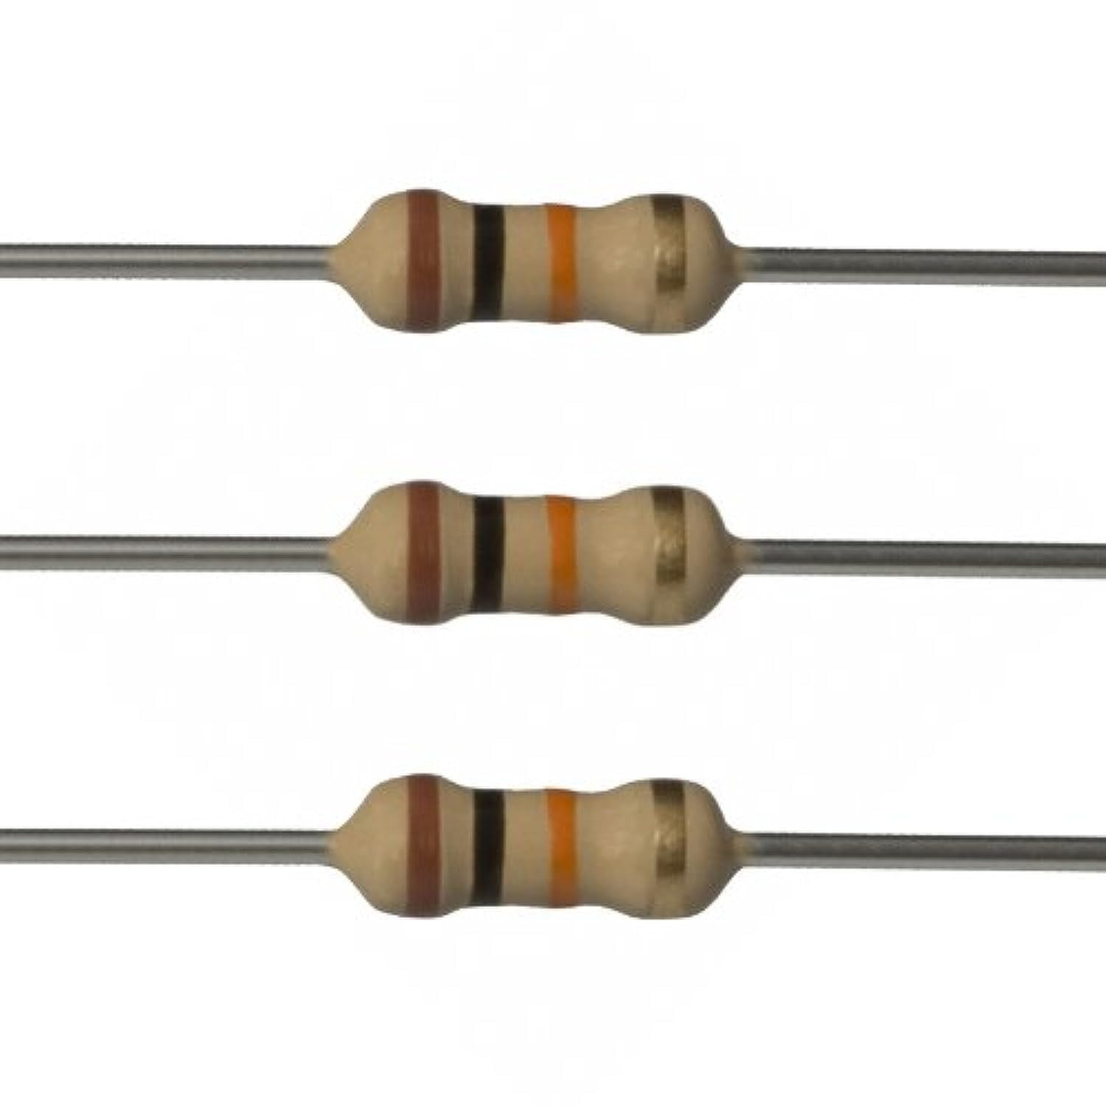
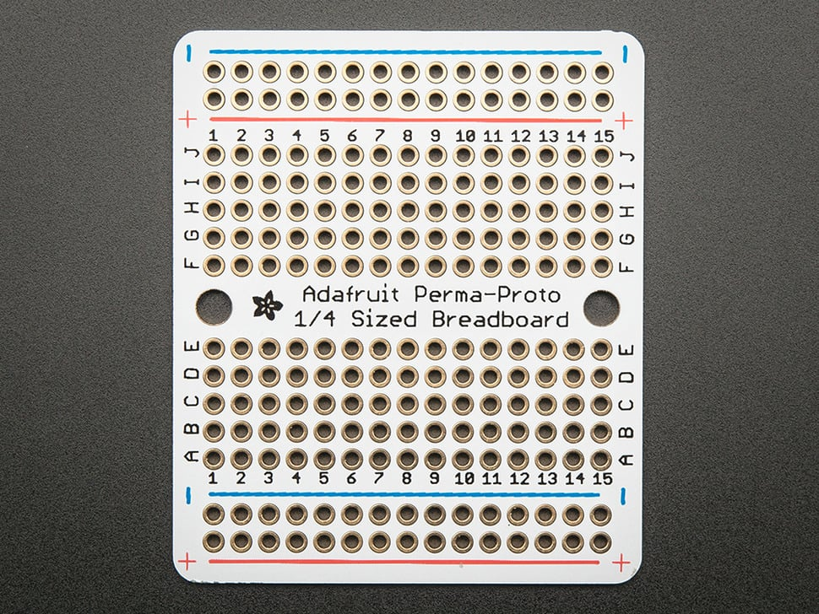
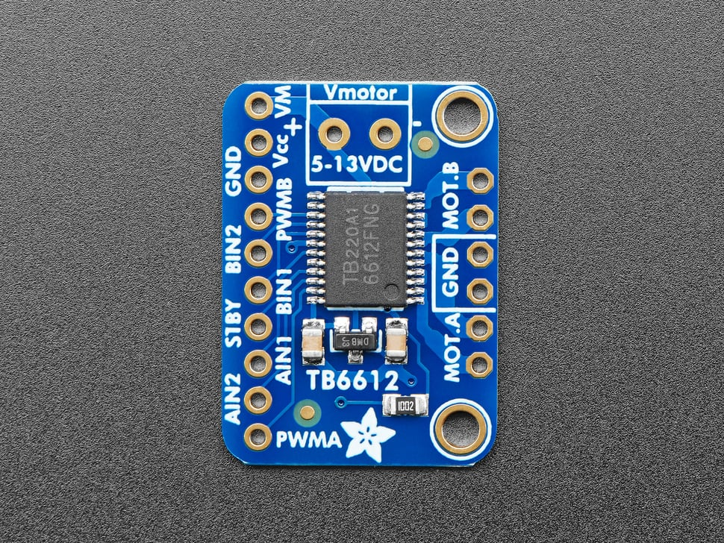
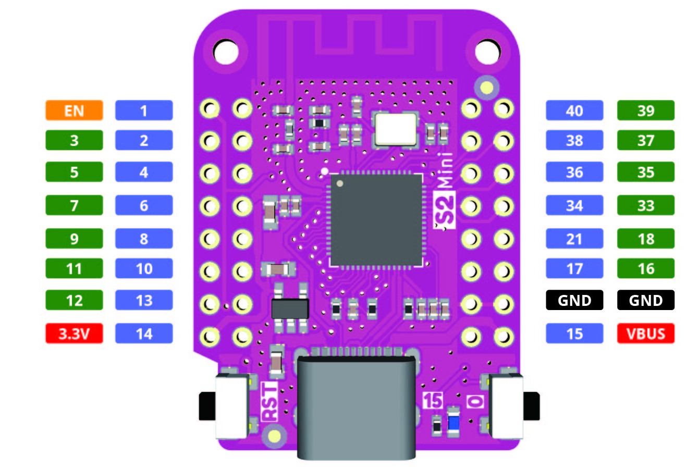
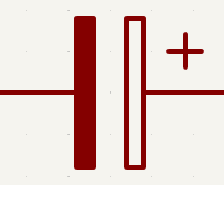
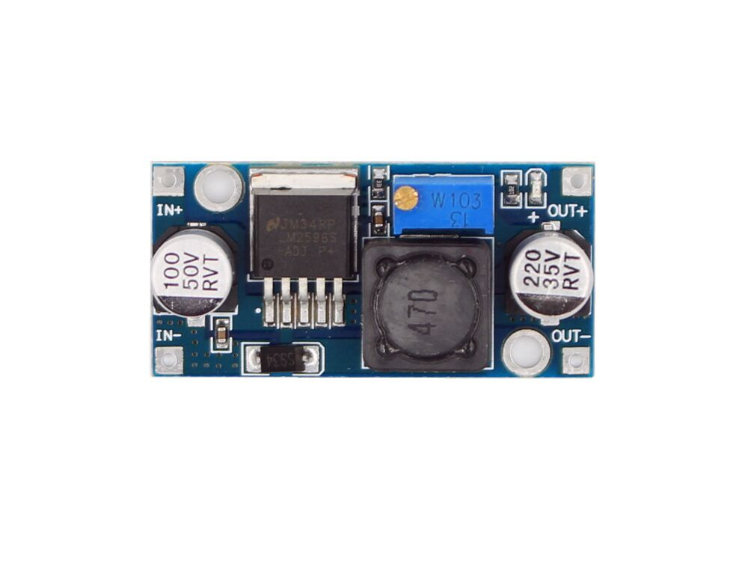
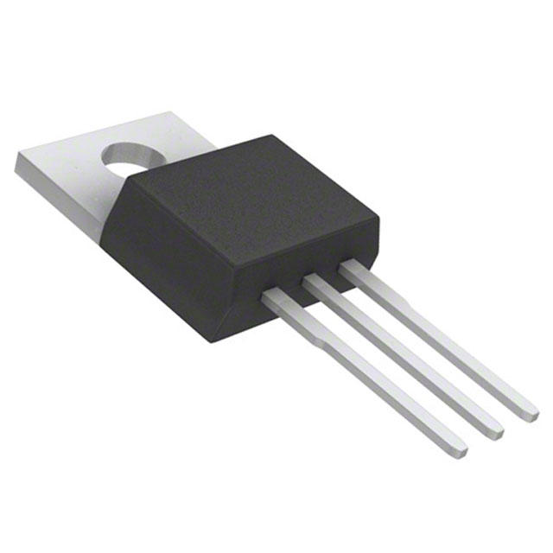
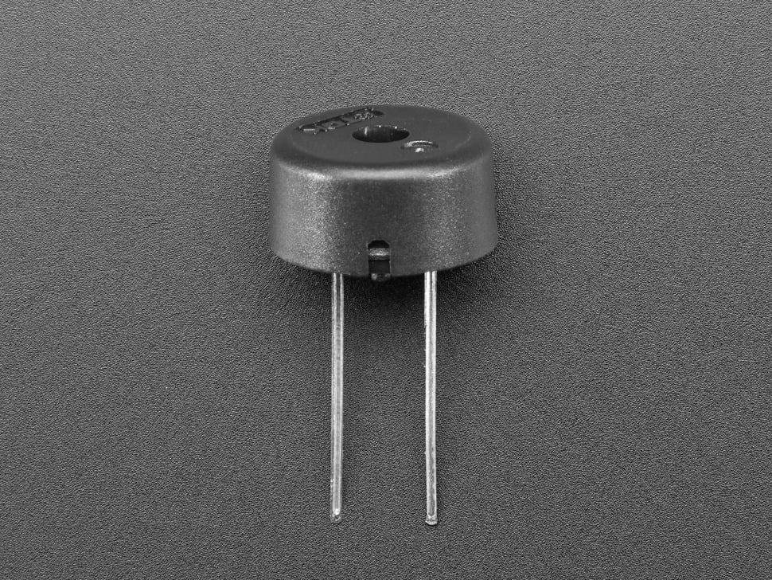
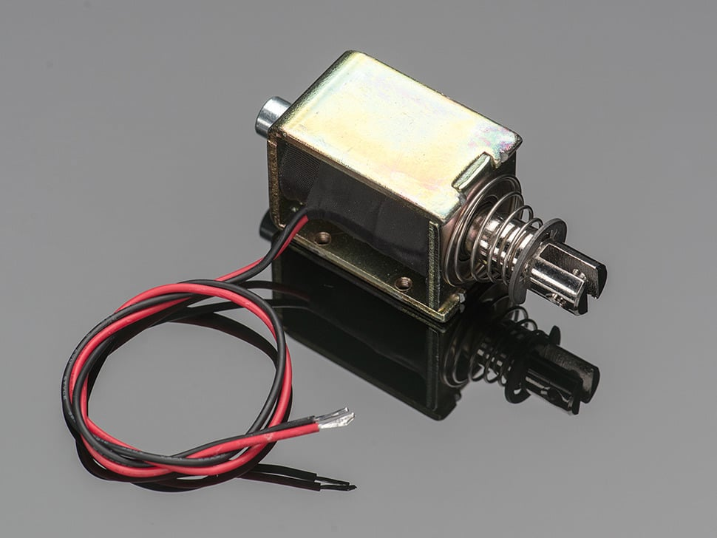
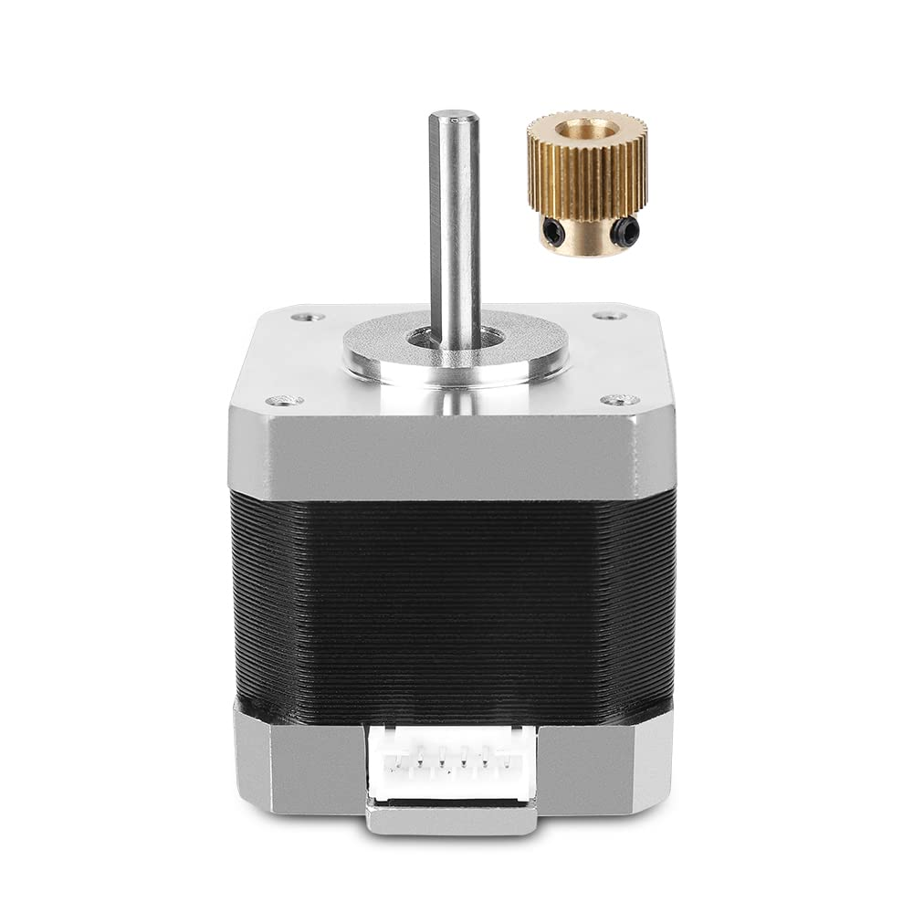
12V
3.3V, Ground, Pin 5, Pin 7, and Pin 9 to keyboard
10kOhm
1N4007
-
2.1mm Barrel Jack, 12V input
NC–NO–C
+
N
12V
3.3V
RFP30N06LE
*
**
G-D-S
PS1240 Piezo
5V
*I used a separate set of 12V and Gnd wires going to the buck converter and each of the motor drivers but combined the wires on this diagram because I was getting lazy.
**A note on the crisscross: I used JST-XH connectors for the power/ground to the buck converter and stepper motors. They take up an obscene amount of space. If you decide to just solder the wires to the board then you’ll have far more room to work with and won’t have to cross things over as much.
Red to red
Green to black
Linear Actuator
Roller Motor
X- Motor
Note: If your motor is turning the wrong way just reverse the order of the wires.

Slide 2
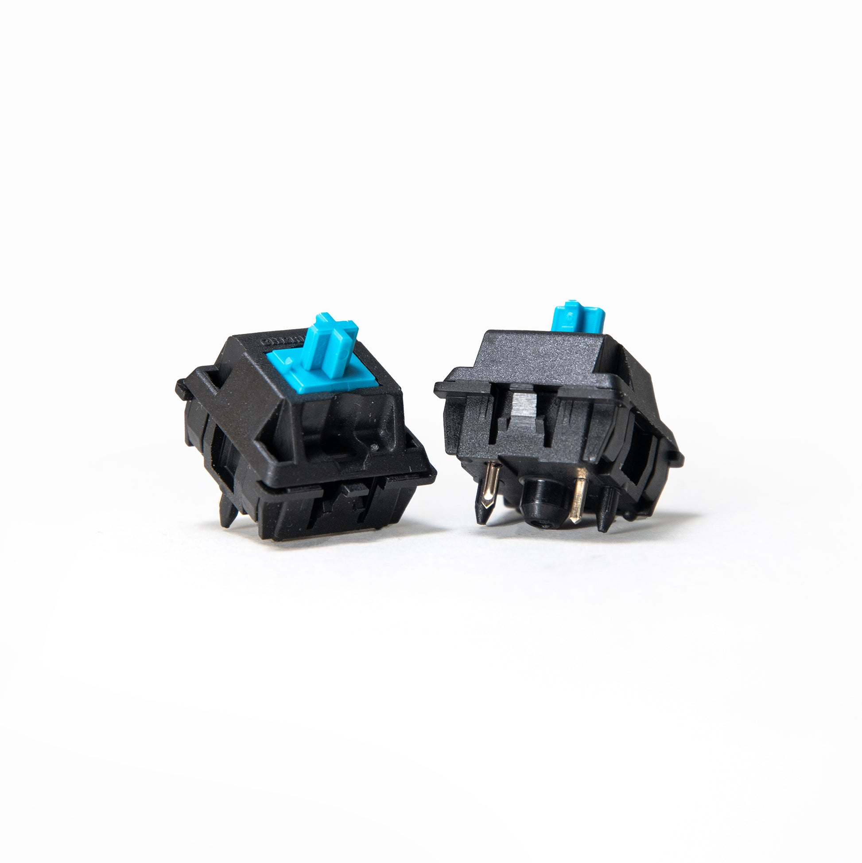
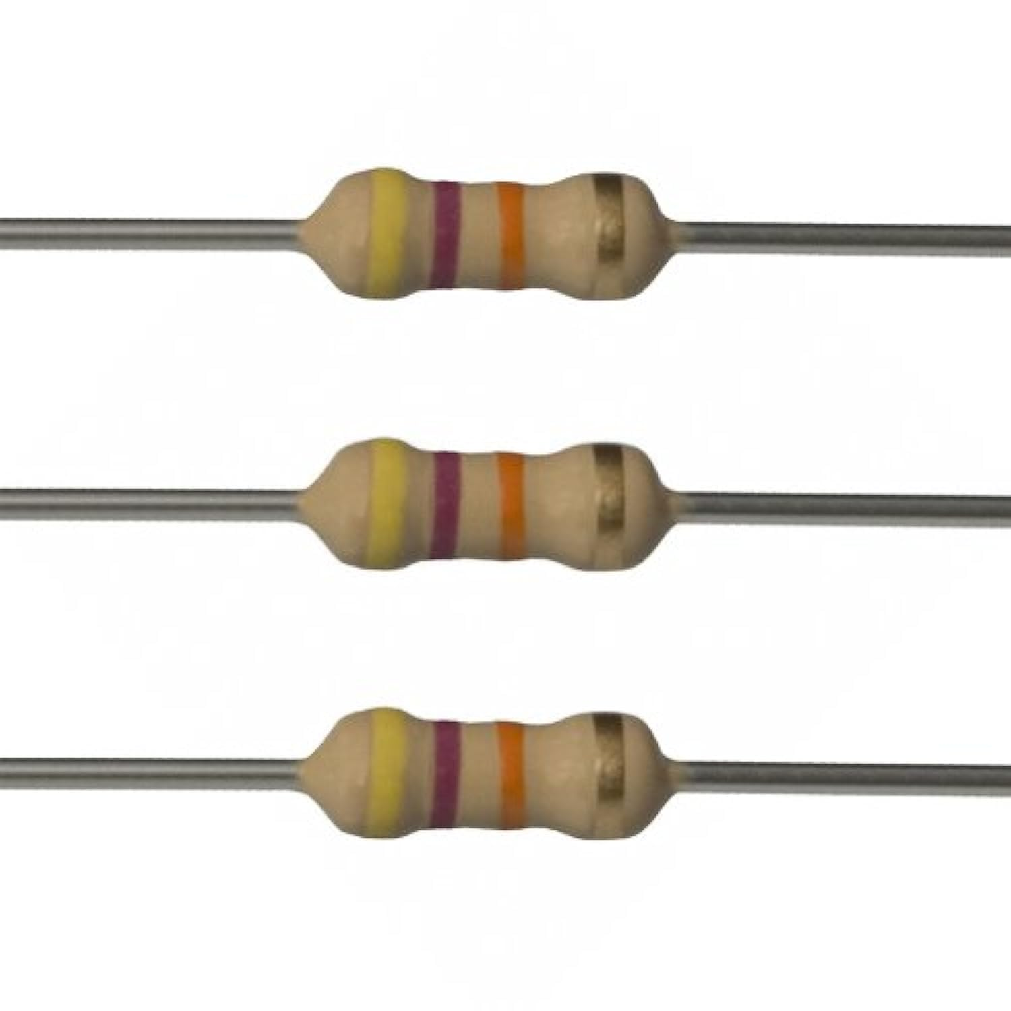
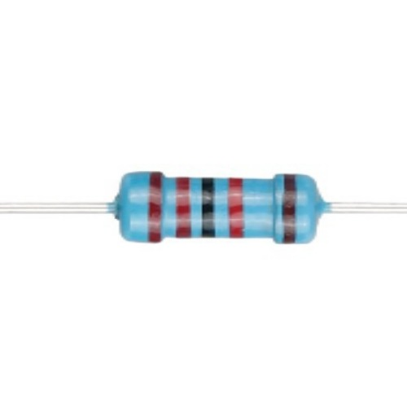
Note: The buttons have to be inserted into the top of the keyboard frame before you solder them. I’m working to find some plugs that fit the switches so that this won’t be an issue in the future.
3.3V, Ground, Pin 5, Pin 7, and Pin 9 from main electronics
Button 1
Button 2
Button 3
Button 4
Button 5
Button 6
47kOhm
22kOhm
10kOhm
Button 7
Button 8
Button 9

Slide 4
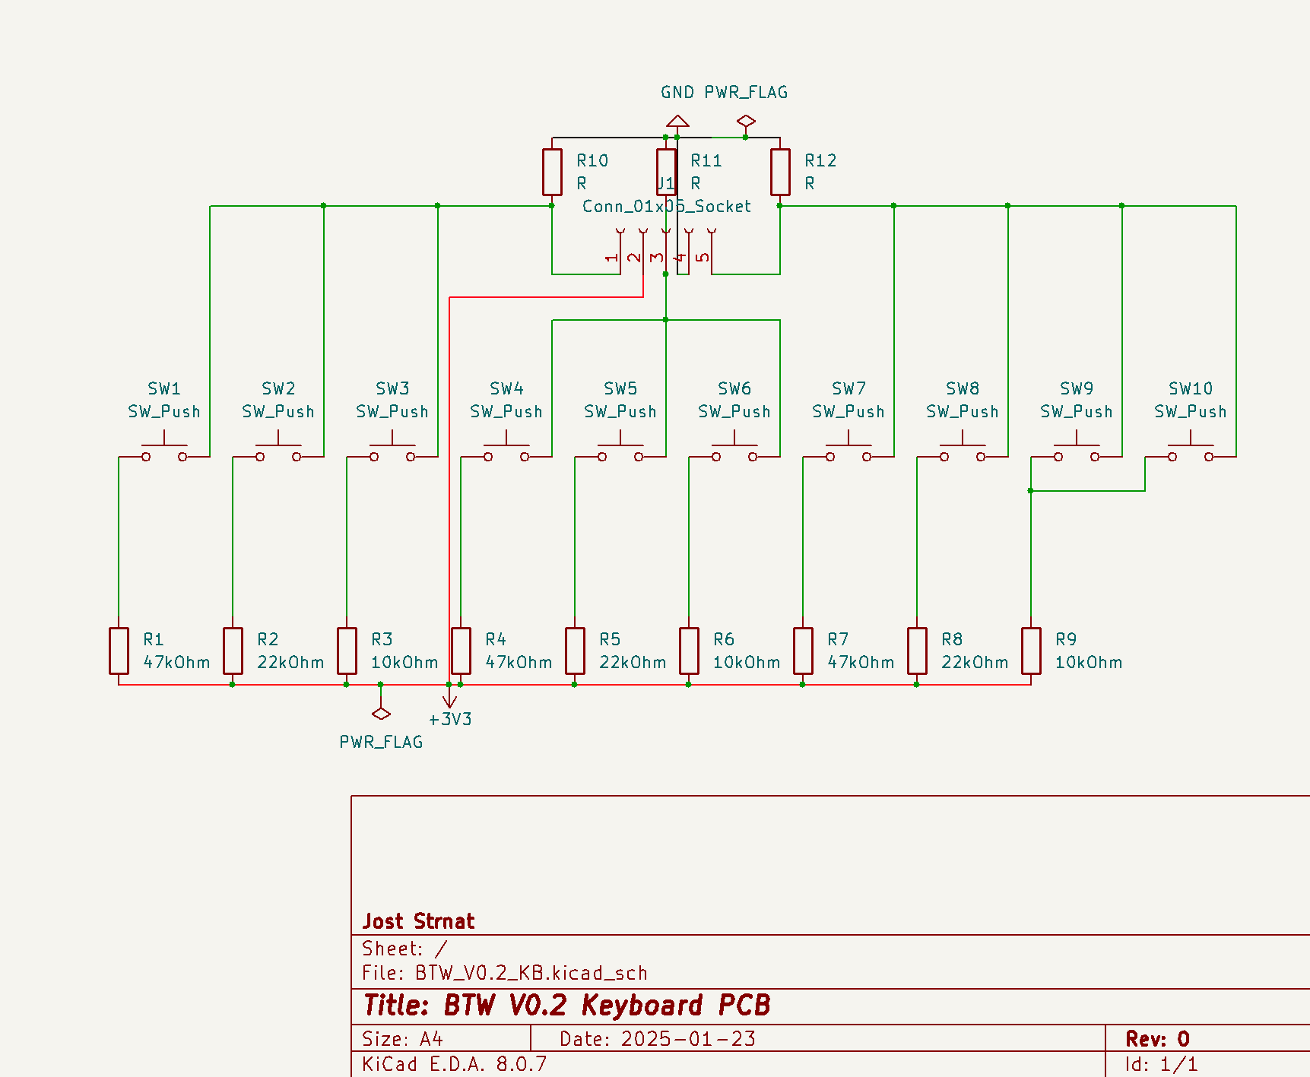
Keyboard PCB

Slide 5
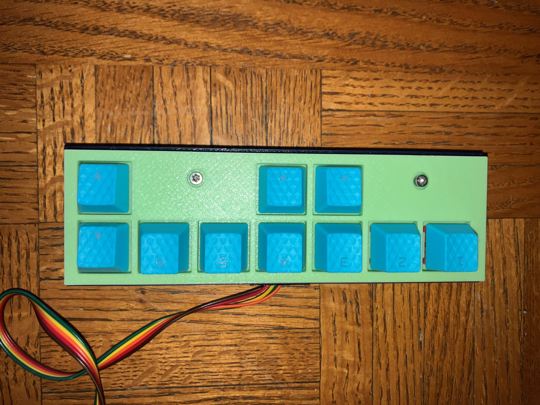
Keyboard labeling buttons
1
2
3
4
5
6
8
7
7
9

Slide 6
Keyboard labeling buttons
Keys 8+9
Beginning of Line
Punch (Either or both keys)

Slide 7
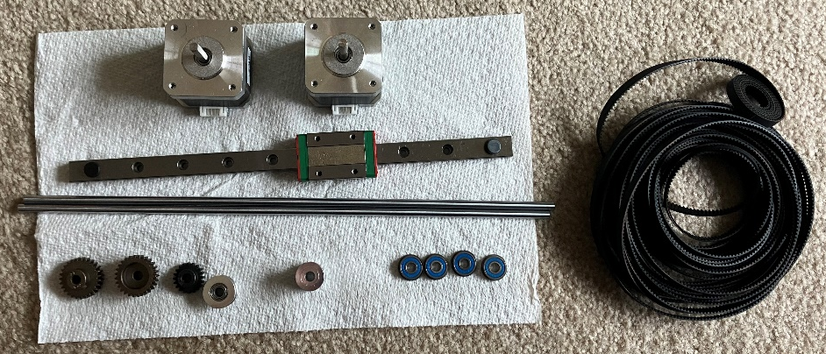
Stepper Motors
250mm Linear Rail
Belt
300mm Linear Rods
Gears
Idler
Pulley Wheel
Bearings

